Slide 1
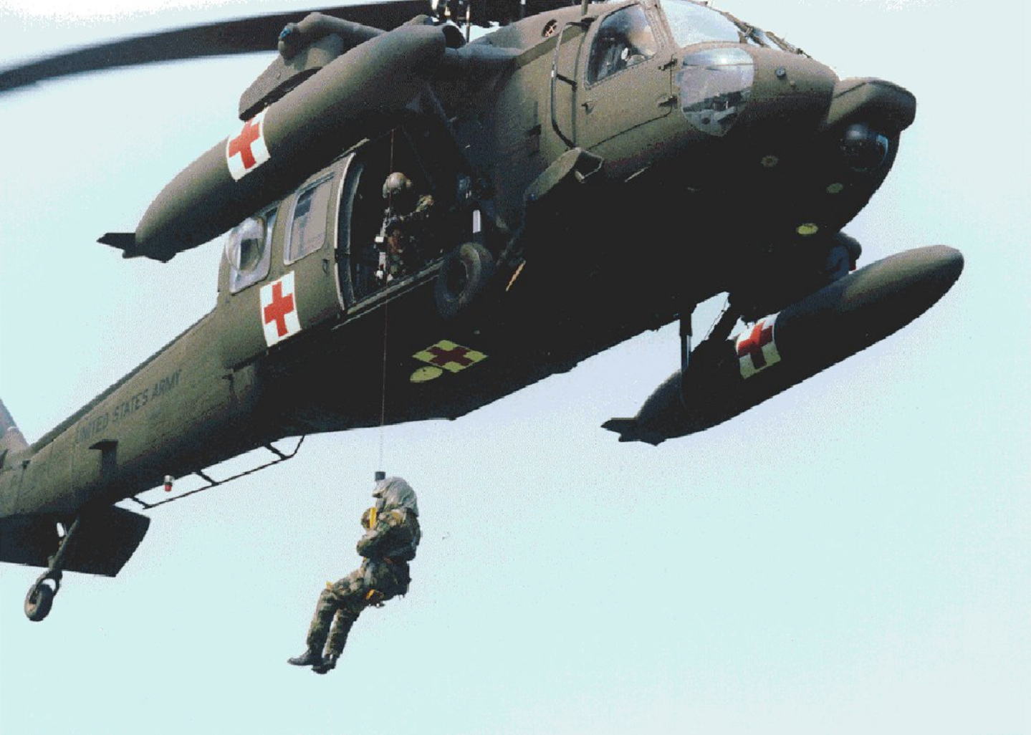
Lesson 8
Requesting Medical Evacuation

Slide 2
TASK
Prepare and transmit a medical evacuation (MEDEVAC) request
CONDITIONS
Given information on simulated casualty or casualties, MEDEVAC request guide, a pencil or other writing instrument, paper, and a simulated transmitting device
STANDARDS
Score a GO on the performance checklist

Slide 3


Slide 4
MEDICAL EVACUATION
MEDEVAC- Using medical vehicles with
medical personnel onboard
CASEVAC- Using non-medical vehicles with
non-medical personnel onboard

Slide 5
MEDICAL EVACUATION REQUESTS
Air and Ground medical evacuation
requests are submitted in a
standardized format
Information contained in that request
is used to allocate proper assets

Slide 6
OVERCLASSIFICATION
Proper casualty classification is
needed to ensure that those casualties in
greatest need are evacuated first to ensure
survival
Casualties will be picked up as soon as
possible

Slide 7
PREPARING A MEDEVAC REQUEST
Use nine-line format
Use brevity codes
Transmit lines 1-5 to begin mission.
If possible submit lines 6-9 at same time, or
en route.

Slide 8
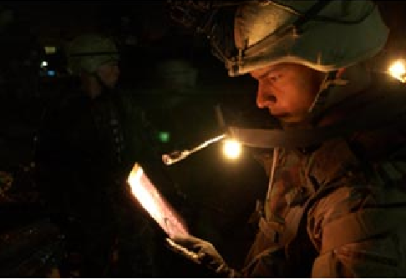
LINES 1- 5 OF MEDEVAC REQUEST
Line 1: Location of Pickup Site
Eight digit grid coordinates
Obtained from unit leader

Slide 9
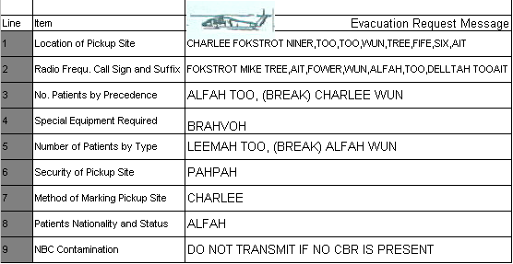
CHARLEE FOKSTROT NINER,TOO,TOO,WUN,TREE,FIFE,SIX,AIT

Slide 10
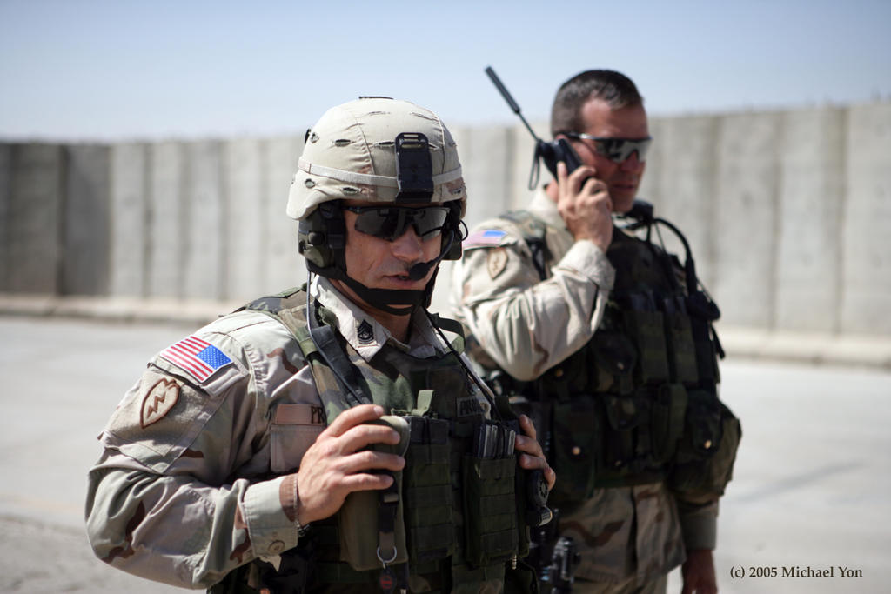
LINES 1- 5 OF MEDEVAC REQUEST
Line 2: Radio Frequency, Call Sign, and
Suffix
YOUR Radio Frequency, Call Sign, and Suffix
Needed so evacuation crew can contact
requesting unit while en route

Slide 11
FOKSTROT MIKE
TREE,AIT,FOWER,WUN,ALFAH,TOO,DELLTAH, TOO, AIT

Slide 12
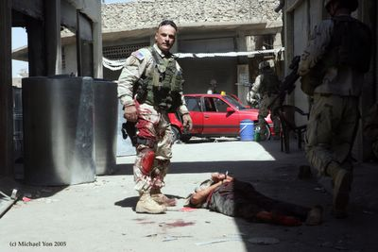
LINES 1- 5 OF MEDEVAC REQUEST
Line 3: Number of Patients by Precedence
A – Urgent
Emergency that should be evacuated as soon
as possible within a maximum of 2 hours in
order to save life, limb, or eye sight
Cardiorespiratory distress
Shock not responding to IV therapy
Prolonged unconsciousness
Head injuries w/ signs of decreased LOC
Burns covering 20-80% of total body surface area

Slide 13
LINES 1- 5 OF MEDEVAC REQUEST
B – Urgent Surgical
Emergency that should be evacuated within 2
hours to the nearest surgical unit
Decreased circulation in the extremities
Open chest and / or abdominal wounds w/
decreased blood pressure
Penetrating wounds
Uncontrollable bleeding or open fractures w/
severe bleeding
Severe facial injuries

Slide 14
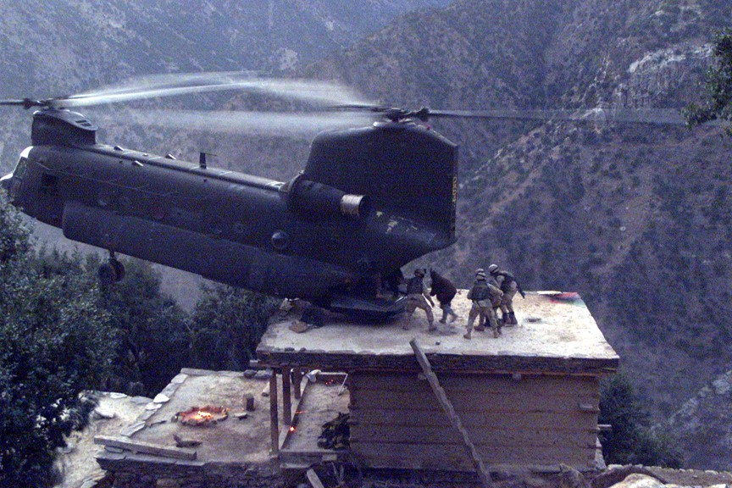
LINES 1- 5 OF MEDEVAC REQUEST
C – Priority
Sick or wounded person requiring prompt
medical care and should be evacuated within
4 hours or the casualty’s medical condition
could deteriorate to such a degree that he
could become an urgent precedence

Slide 15
LINES 1- 5 OF MEDEVAC REQUEST
Closed chest injuries
Brief periods of unconsciousness
Open or closed fractures
Abdominal injuries w/ no decreased blood pressure
Eye injuries that do not threaten eyesight
Spinal injuries
Burns on hands, face, feet, genitalia, or perineum
even if under 20% of body surface

Slide 16
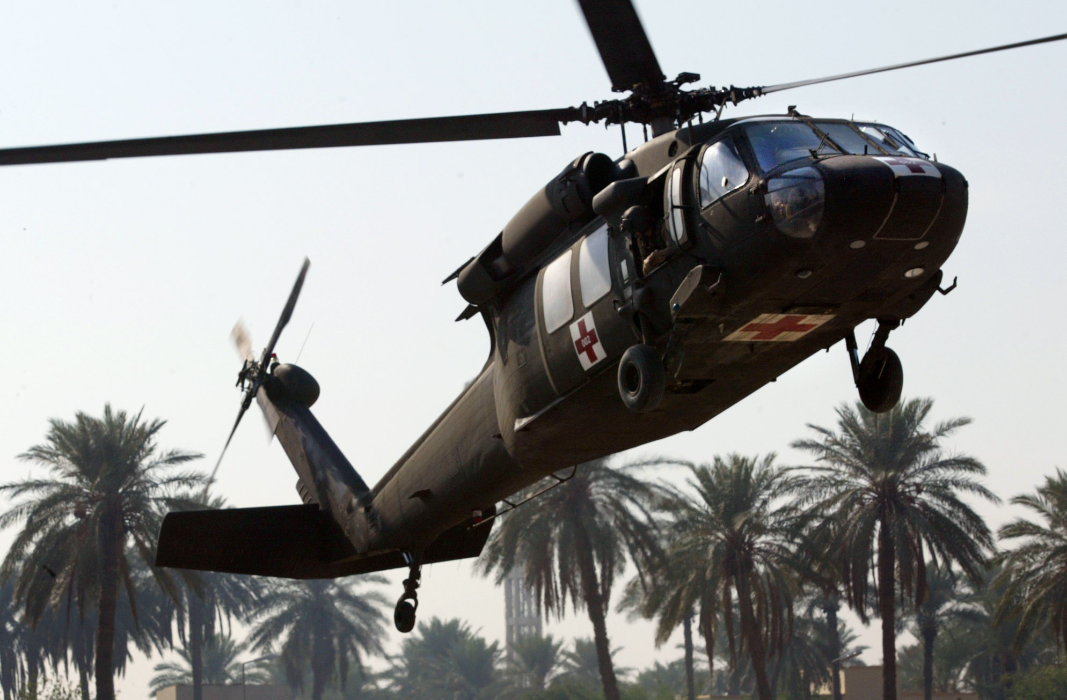
LINES 1 - 5 OF MEDEVAC REQUEST
D – Routine
Sick or wounded person requiring evacuation, but
whose condition is not expected to deteriorate
significantly. The casualty should be evacuated within
24 hours
Simple fractures
Open wounds including chest injuries w/o respiratory
distress
Psychiatric cases
Terminal cases

Slide 17
LINES 1 - 5 OF MEDEVAC REQUEST
E – Convenience
Person who is being medically evacuated for
medical convenience rather than necessity
Minor open wounds
Sprains and strains
Minor burns under 20% of total body surface
area excluding hands, face, feet, genitalia, or perineum.

Slide 18
ALFAH TOO, (BREAK) CHARLEE WUN

Slide 19
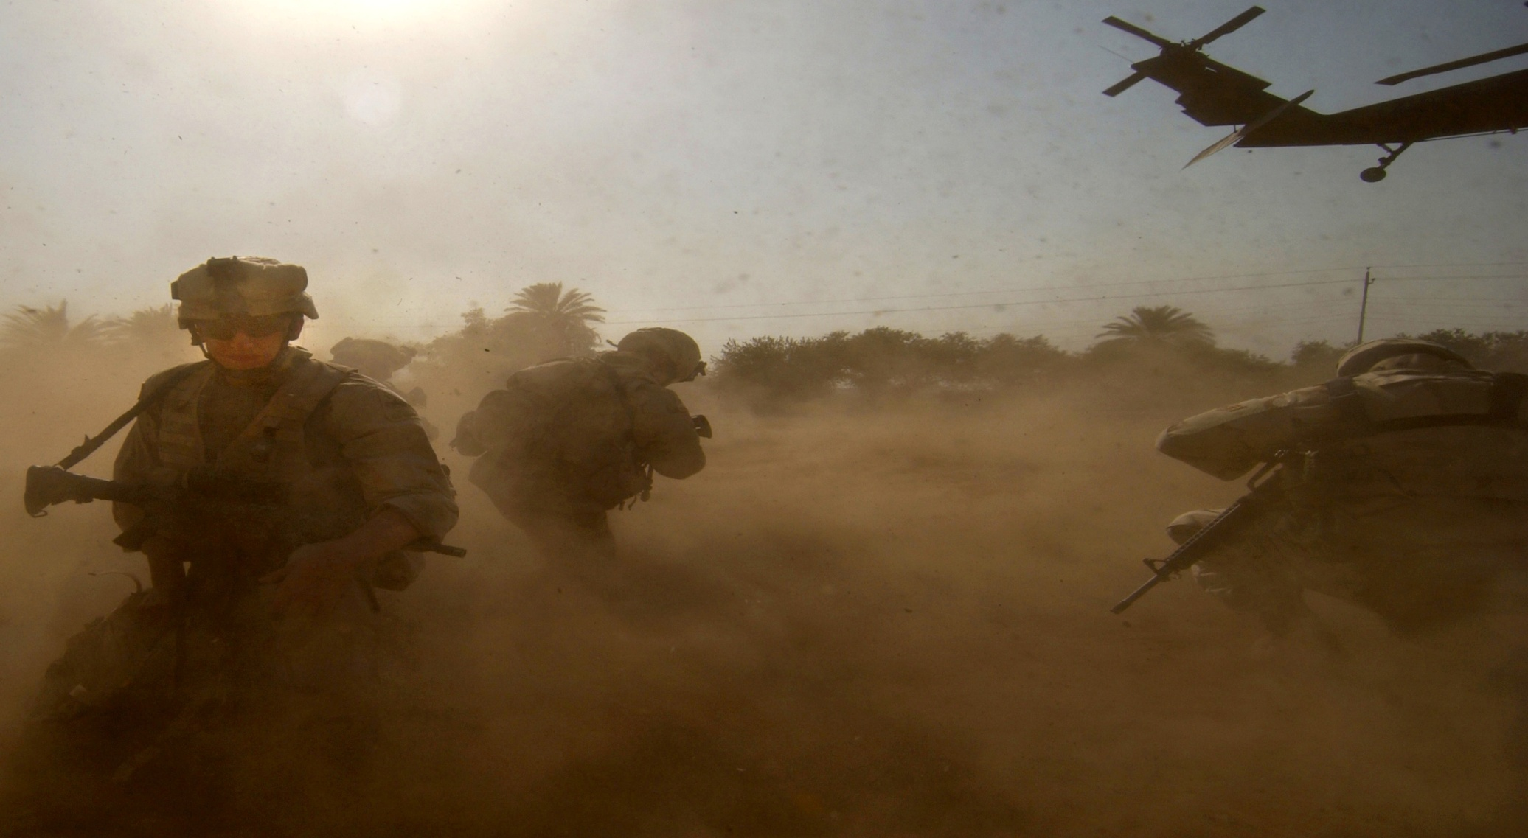
LINES 1- 5 OF MEDEVAC REQUEST
Line 4: Special equipment needed
A – None
B – Hoist
C – Extraction Equipment
D – Ventilator

Slide 20
BRAHVOH

Slide 21
LINES 1- 5 OF MEDEVAC REQUEST
Line 5: Number of Patients by Type
Litter – L + # of Patients
Ambulatory – A + # of Patients

Slide 22
LEEMAH TOO, (BREAK) ALFAH WUN

Slide 23
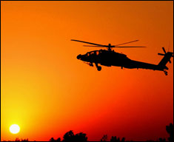
LINES 6 - 9 OF MEDEVAC REQUEST
Line 6: Security of Pickup Site (Wartime)
N – No Enemy in Area
P – Possible Enemy in Area (caution)
E – Enemy Troops in Area (caution)
X – Enemy Troops in Area (armed escort
required)

Slide 24
PAHPAH

Slide 25
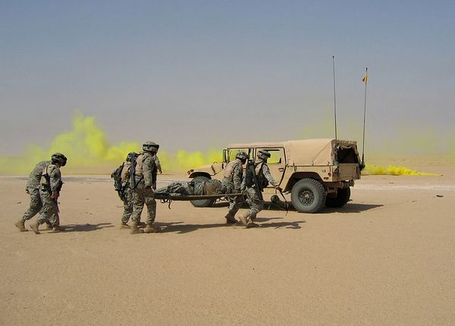
LINES 6 - 9 OF MEDEVAC REQUEST
Line 7: Method of Marking Pickup Site
A – Panels
B – Pyrotechnic Signal
C – Smoke Signal
D – None
E – Other

Slide 26
CHARLEE

Slide 27
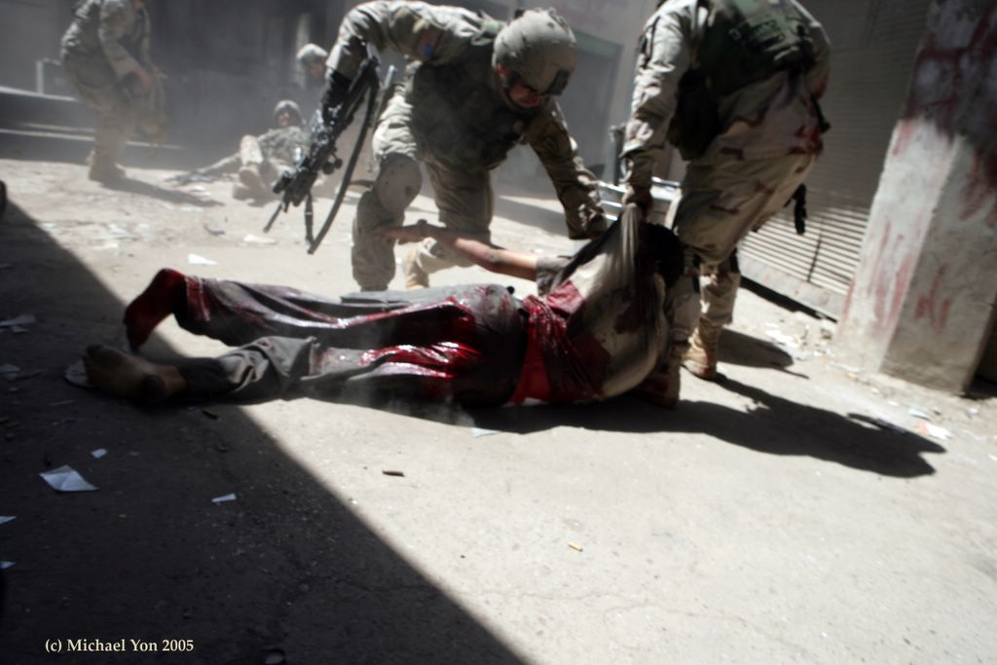
LINES 6 - 9 OF MEDEVAC REQUEST
Line 8: Casualty Nationality & Status
A – U.S. Military
B – U.S. Civilian
C – Non-U.S. Military
D – Non-U.S. Civilian
E – EPW
Line 9: NBC Contamination (Wartime)
N – Nuclear, B – Biological, C – Chemical

Slide 28
ALFAH

Slide 29
DO NOT TRANSMIT IF NO CBR IS PRESENT

Slide 30
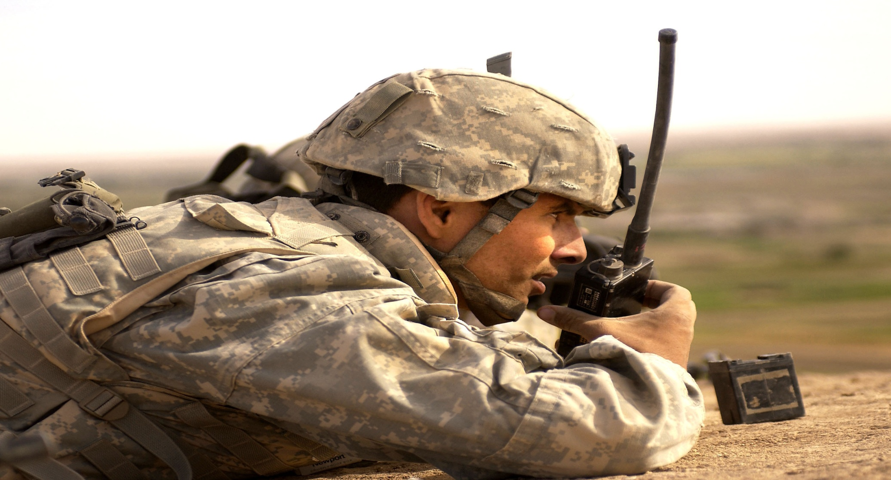
TRANSMITTING RULES
During wartime, brevity codes must be used in preparing all medical evacuation requests
Brevity codes should be listed in the Signal Operating Instruction (SOI) or from the Automated Net Control Device (ANCD)

Slide 31
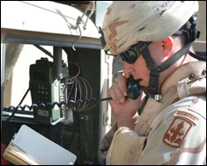
TRANSMITTING A MEDEVAC REQUEST
Collect Information
Begin Transmission
“I HAVE A MEDEVAC REQUEST OVER”
Break for acknowledgement
Transmit Request
Transmit first 5 lines, if possible all 9
Give line number followed by applicable
information
Use phonetic letters and numbers

Slide 32
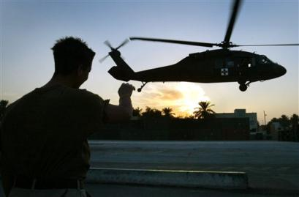
TRANSMITTING A MEDEVAC REQUEST
End Transmission
After transmitting request, state “OVER”
Wait for acknowledgement of request or for
additional information
Monitor Frequency
Monitor Frequency given in line 2, MEDEVAC
will contact you if needed
Mark Site
mark the pickup site as indicated
in line 7.

Slide 33
Complete lesson exercise Question 13; page 8-19
Frequency: FM 8720

Slide 34
Line | Item | Medical Evacuation Request
1 | Location of pickup site.
2 | Radio freq., call sign and suffix.
3 | Patients by precedence.
4 | Special equipment.
5 | Patients by type.
6 | Security of pickup site.
7 | Method of marking pickup site.
8 | Nationality and status.
9 | NBC contamination.
GH11723541
FM 8720 Battle 7
1 B break 1 D
A
1 L break 1 A
N
A
A

Slide 35
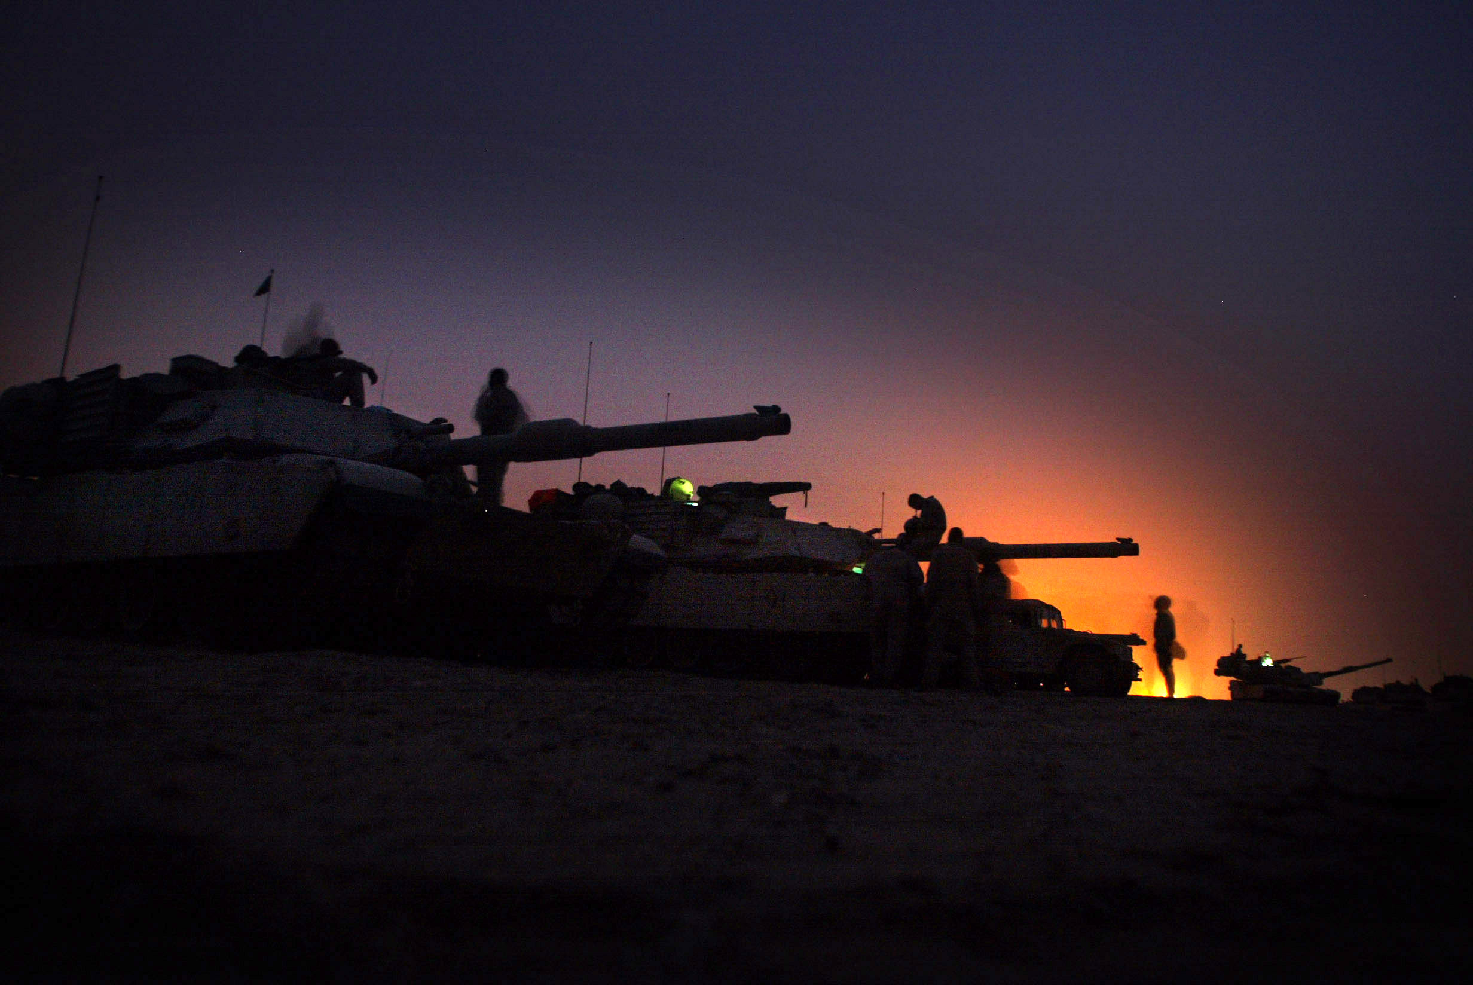
QUESTIONS?

